Slide 1
FUNDAMENTAL OF MULTIMEDIA
TOPIC 5
FUNDAMENTAL OF MULTIMEDIA
5.1 Introduction to Multimedia
5.2 Mode of Multimedia Interactivity
5.3 Multimedia Software
5.4 Medium of Distribution

Slide 2
FUNDAMENTAL OF MULTIMEDIA
5.1 Introduction to Multimedia
Learning Outcome
At the end of this topic,
students should be able to:
1. Define multimedia
2. Describe the elements of multimedia
3. State the applications of multimedia

Slide 3
FUNDAMENTAL OF MULTIMEDIA
5.1 Introduction to Multimedia
“Multimedia is any combination of text, graphic art, sound, animation, and video delivered by computer or other electronic means.”
(Vaughan, 2011)
“Multimedia refers to any application that combines text with graphics, animation, audio, video, and/or virtual reality.”
(Shelly & Vermaat, 2012)

Slide 4
FUNDAMENTAL OF MULTIMEDIA
5.1 Introduction to Multimedia
Multimedia
Various, many, multiple
hardware or software used for communicating
An interactive communication process or presentation of information by using a combination of text, audio, graphic, video and animation, OR
A combination of different media via a computer system.

Slide 5
FUNDAMENTAL OF MULTIMEDIA
5.1 Introduction to Multimedia

Slide 6
FUNDAMENTAL OF MULTIMEDIA
5.1 Introduction to Multimedia
TEXT
“Using text and symbols for communication and delivers information that can have potent meaning” (Vaughan,2011)
Text is combination of alphabets, numbers and symbol to form a sentence or word that is used to avoid misunderstanding
Text

Slide 7
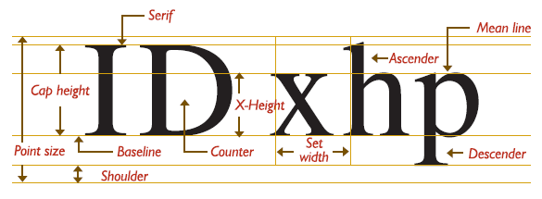
FUNDAMENTAL OF MULTIMEDIA
5.1 Introduction to Multimedia
Can be developed using any text editor (such as Notepad, WordPad)
However to give special effects to text, graphics software is needed. (such as Photoshop, illustrator)
Can have different typeface, size, color and style, background color to suit the professional requirement of the multimedia software.
“A typeface is a family of graphic characters (font) that usually includes many type sizes and styles.”
(Vaughan, 2011)
Text

Slide 8
FUNDAMENTAL OF MULTIMEDIA
5.1 Introduction to Multimedia
Font can be altered to create interesting effects
Cases
Serif vs. Sans Serif
Choosing Text Fonts
Hypertext
“The text more accessible and meaningful can then be called hypertext; because the words, sections, and thoughts are linked, the user can navigate through text in a nonlinear way, quickly and intuitively.”
(Vaughan, 2011)
Text

Slide 9
FUNDAMENTAL OF MULTIMEDIA
5.1 Introduction to Multimedia
Effective multimedia program should consider :-
1. The position of the text on the screen
Text
2. Length of the message
3. Legibility of the text

Slide 10
FUNDAMENTAL OF MULTIMEDIA
5.1 Introduction to Multimedia
GRAPHIC
“A graphic or graphical image is a digital representation of non-text information such as a drawing, chart or photo”
(Shelly & Vermaat,2012)
Graphic is a digital representation of images or non-text information
Purpose of graphic :-
a) help to develop an attractive application
b) help to illustrate ideas through still pictures
Graphic

Slide 11
FUNDAMENTAL OF MULTIMEDIA
5.1 Introduction to Multimedia
Still images are generated by the computer in two ways: as bitmaps (or paint graphics) and as vector (or just plain “drawn”) graphics.
Bitmaps may also be called “raster” images. Likewise, bitmap editors are sometimes called “painting” programs. And vector editors are sometimes called “drawing” programs.
Bitmaps are used for photo-realistic images and for complex drawings requiring fine detail.
Vector-drawn objects are used for lines, boxes, circles, polygons, and other graphic shapes that can be mathematically expressed in angles, coordinates, and distances.
Graphic

Slide 12
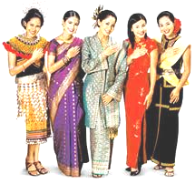
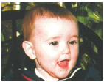
FUNDAMENTAL OF MULTIMEDIA
5.1 Introduction to Multimedia
Bitmap images | “A bitmap is a simple matrix of the tiny dots that form an image & are displayed on a computer screen or printed.” (Vaughan, 2011) Real images that can be captured from devices such as cameras or scanners.
Vector graphics | “A vector is a line that is described by the location of its two endpoints.” (Vaughan, 2011) Draw on the computer and only required a small amount of memory
Graphic

Slide 13
FUNDAMENTAL OF MULTIMEDIA
5.1 Introduction to Multimedia
VIDEO
“Video consists of images displayed in motion.”
(Shelly & Vermaat, 2012)
Video is the product of recording moving images by using a camera or video machine.
Technology of electronically capturing, recording, processing, storing, transmitting, & reconstructing a sequence of still images representing scenes in motion.
The purpose of video is to provides a powerful impact in a multimedia program.
Video

Slide 14
FUNDAMENTAL OF MULTIMEDIA
5.1 Introduction to Multimedia
Why Digital Video?
Advantages | Disadvantages
video clips can be edited easily the digital video files can be stored like any other files in the computer and the quality of the video can still be maintained the video files can be transferred within a computer network it allows editing in any part of the video | these digital video files are large in size transferring these files can take a long time especially when using the Internet.
Video

Slide 15
FUNDAMENTAL OF MULTIMEDIA
5.1 Introduction to Multimedia
AUDIO
“Audio includes music, speech, or any other sound.”
(Shelly & Vermaat, 2012)
Audio is use of speech, music and sound effects.
The purpose of audio is to gives life to the static state of multimedia.
Several types of sound such as human voices, instrumental notes, natural sound, speech, music, sound effects.
Basic types of audio or sound: (1) analog and (1) digital audio.
Audio

Slide 16
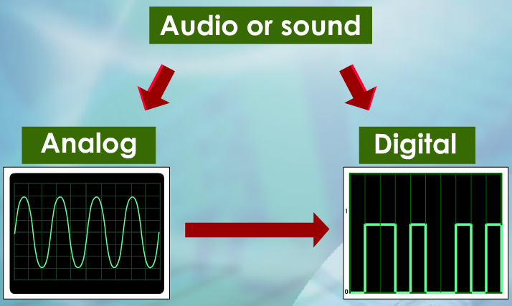
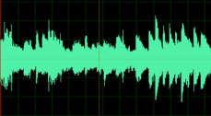
FUNDAMENTAL OF MULTIMEDIA
5.1 Introduction to Multimedia
Types of audio or sound
Digital Audio | Analog Audio
the digital sampling of the actual sound used in multimedia. | the original sound signal. we can record analog audio file. special audio editors like Audacity can be use to convert analog audio files into digital audio files.
Audio

Slide 17
FUNDAMENTAL OF MULTIMEDIA
5.1 Introduction to Multimedia
ANIMATION
“By definition, animation is the act of making something come alive or makes static presentations come alive.”
(Vaughan, 2011)
“Appearance of motion created by displaying a series of still images in sequence.”
(Shelly & Vermaat, 2012)
Animation is a process of making a static/still image look like it is moving.
Purpose of an animation :-
a) To make static presentations come alive
b) To create an examples for dangerous and costly events
In multimedia, digital animation is used.
Animation
17

Slide 18
FUNDAMENTAL OF MULTIMEDIA
5.1 Introduction to Multimedia
2 types of digital animation
2D (2 Dimension) | In 2-D space, the visual changes that bring an image alive occur on the flat Cartesian x and y axes of the screen. A blinking word, a color-cycling logo (where the colors of an image are rapidly altered according to a formula), or a button or tab that changes state on mouse rollover to let a user know it is active are all examples of 2-D animations. (Vaughan, 2011)
3D (3 Dimension) | “In 3-D animation, software creates a virtual realm in three dimensions, & changes (motion) are calculated along all three axes (x, y, and z), allowing an image or object that itself is created with a front, back, sides, top, and bottom to move toward or away from the viewer, or, in this virtual space of light sources and points of view, allowing the viewer to wander around and get a look at all the object’s parts from all angles.” (Vaughan, 2011) movements like spinning and flying across the screen are some samples of animations.
Animation
18

Slide 19
FUNDAMENTAL OF MULTIMEDIA
5.1 Introduction to Multimedia
Applications of Multimedia
1. Education
2. Entertainment
3. Public Places
4. Business
19

Slide 20
FUNDAMENTAL OF MULTIMEDIA
5.2 Mode of Multimedia Interactivity
Learning Outcome
At the end of this topic,
students should be able to:
1. Differentiate between modes of interactivity

Slide 21
FUNDAMENTAL OF MULTIMEDIA
5.2 Mode of Multimedia Interactivity
“When you allow an end user - also known as the viewer of a multimedia project - to control what and when the elements are delivered, it is called interactive multimedia.”
(Vaughan, 2011)
Interactivity refers to the way users interact with a multimedia application or program.
User can use input devices such as a keyboard, joystick, mouse and touch screen to interact with the application through the computer.
Two major categories of interactivity in multimedia – linear and non-linear interactivity.

Slide 22
FUNDAMENTAL OF MULTIMEDIA
5.2 Mode of Multimedia Interactivity
1. Linear Interactivity
“Users navigate sequentially, from one frame or bite of information to another.” (Vaughan, 2011)
Does not allow the user to have control of the sequence and progress of the multimedia contents.
User interacts with the multimedia application without controlling the progress of the content.
User is a passive receiver of the multimedia content most of the time.

Slide 23
FUNDAMENTAL OF MULTIMEDIA
5.2 Mode of Multimedia Interactivity
1. Linear Interactivity
Content is usually arranged in sequence :
Example: a movie - although a movie uses a combination of audio, graphics and animations, the user has no control over the sequence of events.
Example of linear interactivity

Slide 24
FUNDAMENTAL OF MULTIMEDIA
5.2 Mode of Multimedia Interactivity
2. Non-Linear Interactivity
“Users navigate freely through the content of the project,
unbound by predetermined routes.” (Vaughan, 2011)
Lets the user control the sequence and progress of the multimedia content.
Allows the user to interact with the content according to what the user wants from the content.
Two way communication.
User can control the progress and sequence of the multimedia content by using buttons or links.

Slide 25
FUNDAMENTAL OF MULTIMEDIA
5.2 Mode of Multimedia Interactivity
2. Non-Linear Interactivity
Example:
Uses tools like hypertext to connect a word or a phrase to another screen.
An electronic book with links to another screen is considered as having non-linear multimedia content.
Hypermedia, tool is similar to hypertext; it connects to different media elements such as audio and video.

Slide 26
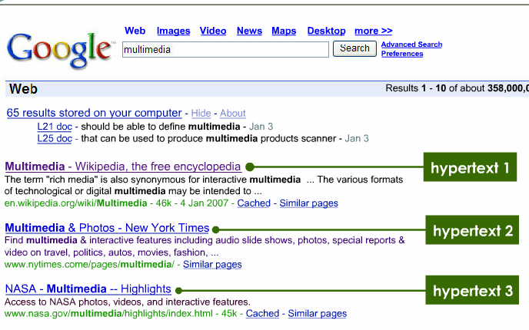
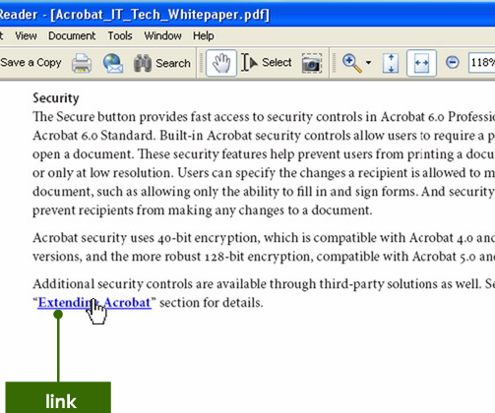
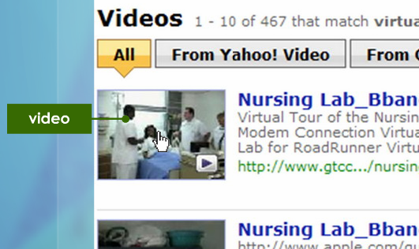
FUNDAMENTAL OF MULTIMEDIA
5.2 Mode of Multimedia Interactivity
2. Non-Linear Interactivity
Hypertext
Electronic Book
Hypermedia

Slide 27
FUNDAMENTAL OF MULTIMEDIA
5.2 Mode of Multimedia Interactivity
Differentiate between Linear & Non-Linear Interactivity
Linear Interactive | Non Linear Interactivity
Does not allow user to control the progress of the content | Allow the user to control with the content according to what the user wants from the content
The user is a passive receiver of the multimedia content most of the time | Two way communication - User is an active user in handling and interacting with the multimedia content.
The content usually arranged in sequence | The sequence of the multimedia content is arranged by using buttons or links

Slide 28
FUNDAMENTAL OF MULTIMEDIA
5.3 Multimedia Software
Learning Outcome
At the end of this topic,
students should be able to:
1. Differentiate among types of multimedia authoring tools.
2. Explain types of editing software

Slide 29
FUNDAMENTAL OF MULTIMEDIA
5.3 Multimedia Software
Authoring Tools
“Multimedia elements are typically sewn together into a project using authoring tools. These software tools are designed to manage individual multimedia elements and provide user interaction.” (Vaughan, 2011)
“Authoring tools are used for designing interactivity and the user interface, for presenting your project on screen, and for assembling diverse multimedia elements into a single, cohesive product.” (Vaughan, 2011)

Slide 30
FUNDAMENTAL OF MULTIMEDIA
5.3 Multimedia Software
Authoring Tools
Authoring tools is a program that helps you write multimedia applications.
Enable you to create a final application by linking together objects such as a paragraph of text graphic or a video.

Slide 31
FUNDAMENTAL OF MULTIMEDIA
5.3 Multimedia Software
Authoring Tools
Three basic metaphor / categories / types of authoring tools :
Time-based authoring tools
Page-based authoring tools
Icon-based authoring tools
More metaphor of authoring tools:
1. Web page authoring tools
Allow user to create Web pages
Some application software include Web page programs
Example : Adobe Dreamweaver, FrontPage, KompoZer
2. Theatrical authoring tools
Multimedia elements – as cast members.
Example : Adobe Director

Slide 32
FUNDAMENTAL OF MULTIMEDIA
5.3 Multimedia Software
Authoring Tools
How authoring tools are classified ?
Way program organizes elements
Sequences events
Delivers

Slide 33
FUNDAMENTAL OF MULTIMEDIA
5.3 Multimedia Software
Classified / feature | Time-based tools | Icon-based tools | Page-based tools
Way program organize multimedia elements (events) | The multimedia elements (events) are presented & organized along a time line Each element arrange in different layer | The multimedia elements (icons) are presented & organized in structural framework (flowchart) The icons & other elements should be played in a logical flow or flowchart | It provides a facility for linking objects to pages or cards Each page or card contains many elements

Slide 34
FUNDAMENTAL OF MULTIMEDIA
5.3 Multimedia Software
Classified / feature | Time-based tools | Icon-based tools | Page-based tools
Sequences events | The tools coordinates: The time each element is played The speed The length of time its remains on the screen | Logical flow or events visually by dragging icons from an icon menu Use visual programming approach to sequencing events | 1 screen = 1 card = 1 page

Slide 35
FUNDAMENTAL OF MULTIMEDIA
5.3 Multimedia Software
Classified / feature | Time-based tools | Icon-based tools | Page-based tools
Example of software | Adobe Flash Adobe Director Ktoon | Adobe Authorware Icon Author | Impress Toolbook (Windows platform) HyperCard (Macintosh platform) Microsoft office presentation

Slide 36
FUNDAMENTAL OF MULTIMEDIA
5.3 Multimedia Software
Classified / feature | Time-based tools | Icon-based tools | Page-based tools
Advantages | Support multi platform Good for create animation Interactive menu | Support multi platform Clear structure Easy editing & updating | Easy to use Provide template Short development time 2. Easy to understand metaphor

Slide 37
FUNDAMENTAL OF MULTIMEDIA
5.3 Multimedia Software
Classified / feature | Time-based tools | Icon-based tools | Page-based tools
Disadvantages | Steep learning curve for advance feature Expensive Increase in file size Increase the download time when insert sound & movie | Difficult to learn Expensive | Some run only in one platform

Slide 38
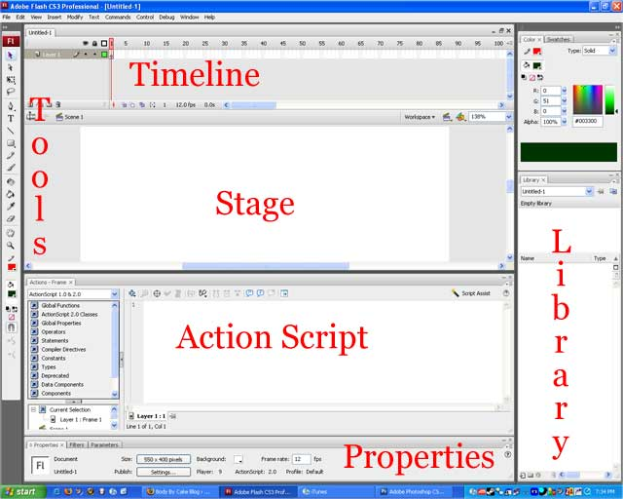
FUNDAMENTAL OF MULTIMEDIA
5.3 Multimedia Software
Time-based Authoring Tools
Interface of Adobe Flash

Slide 39
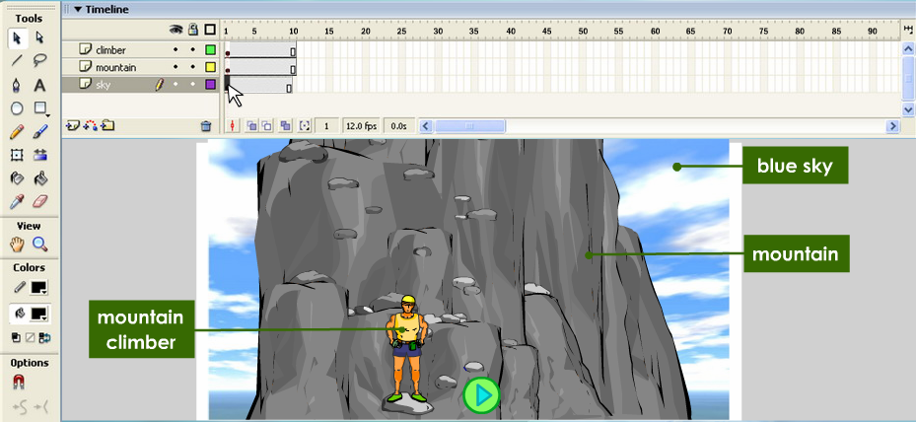
FUNDAMENTAL OF MULTIMEDIA
5.3 Multimedia Software
Time-based Authoring Tools
Timeline
Layer : each layer for 1 element multimedia
Frame:
Interface of Adobe Flash
A simple presentation could contain three layers; layer one could contain a picture of a blue sky, layer two could contain a picture of a mountain and layer three a picture of a mountain climber.

Slide 40
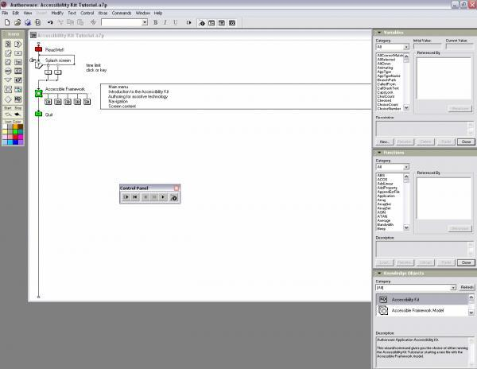
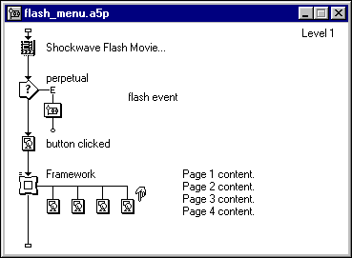
FUNDAMENTAL OF MULTIMEDIA
5.3 Multimedia Software
Icon-based Authoring Tools
Sequencing
Framework:
Interface of Authorware Software

Slide 41
FUNDAMENTAL OF MULTIMEDIA
5.3 Multimedia Software
Icon-based Authoring Tools
Each part is represented an icon (symbolic picture)
Each icon does a specific task, eg: play a sound
Icons are then linked together to form complete applications.
Easily visualize the structure and navigation of the final application.
Interface of Authorware Software

Slide 42
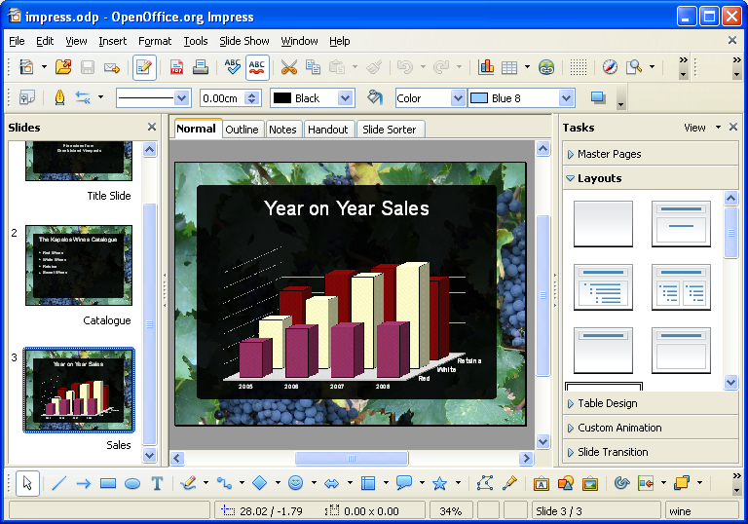
FUNDAMENTAL OF MULTIMEDIA
5.3 Multimedia Software
Page-based Authoring Tools
Interface of Impress

Slide 43
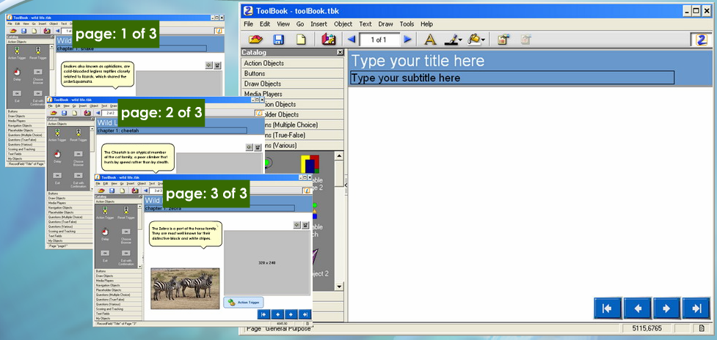
FUNDAMENTAL OF MULTIMEDIA
5.3 Multimedia Software
Page-based Authoring Tools
Interface of Toolbook

Slide 44
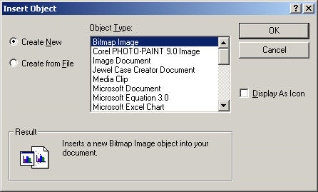
FUNDAMENTAL OF MULTIMEDIA
5.3 Multimedia Software
TERM used in multimedia
Multimedia elements such as text, Still image, Special effect , animation, video and audio.
Multimedia objects (OBJE) are files that contain e.g. images, scanned documents, audio recordings, video clips.
media objects such as buttons, text fields, and graphic object, Video, Audio, Image, Application (like Flash object).
An object is a helper program that provides access to specified data or technologies.

Slide 45
FUNDAMENTAL OF MULTIMEDIA
5.3 Multimedia Software
Editing Software
Definition : software that is use to produce multimedia elements.
Types of editing software :
Text editor
Font editor
Graphic editor
Audio editor
Video editor
Animation editor

Slide 46
FUNDAMENTAL OF MULTIMEDIA
5.3 Multimedia Software
1. Editing Software : Text Editor
Text editor is used to edit plain text
Name of Software | Format files
Microsoft Word | .doc, .docx
OpenOffice Writer | .odt
Notepad | .txt
Wordpad | .rtf

Slide 47
FUNDAMENTAL OF MULTIMEDIA
5.3 Multimedia Software
1. Editing Software : Font Editor
Special font editing tools can be used to make your own type, so you can communicate an idea or graphic feeling exactly.
With these tools, professional typographers create distinct text and display faces.
Graphic designers, publishers, and ad agencies can design instant variations of existing typefaces
Name of Software | Format files
FontLab | .vfb
Fontographer | .fog
BitFonter 3.0 | .bfb
Multimedia : Making It Workpg 50

Slide 48
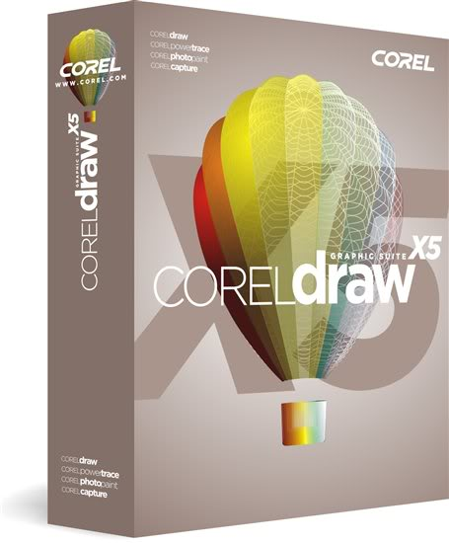
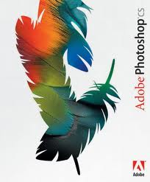
FUNDAMENTAL OF MULTIMEDIA
5.3 Multimedia Software
2. Editing Software : Graphic Editor
Graphic editor can edit images, draw or illustrate pictures or objects.
Name of Software | Format files
GIMP 2.0 | .xcf
Adobe Photoshop | .psd
Corel Draw | .cdr
Microsoft Paint | .bmp

Slide 49
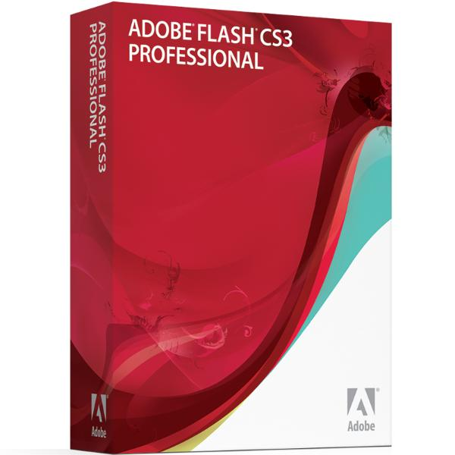
FUNDAMENTAL OF MULTIMEDIA
5.3 Multimedia Software
3. Editing Software : Animation Editor
Animation editors are used for producing 2D, 3D, special effects and animation for the Web.
Name of Software | Format files
3D Blender | .blender
Adobe Flash | .swf
3D Studio Max | .max
Lightwave | .dvs

Slide 50
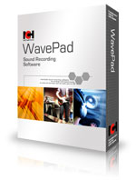
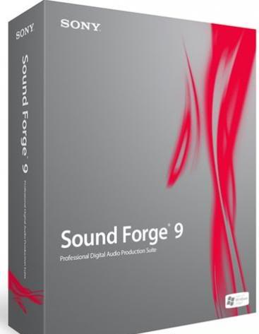
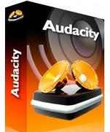
FUNDAMENTAL OF MULTIMEDIA
5.3 Multimedia Software
4. Editing Software : Audio Editor
Audio editor is used for voice recording or producing music and special sound effects.
Name of Software | Format files
Audacity | .aup
Sound Forge | .wav
Wave Pad | .dvs

Slide 51
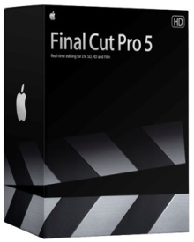
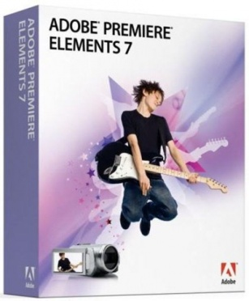
FUNDAMENTAL OF MULTIMEDIA
5.3 Multimedia Software
5. Editing Software : Video Editor
Video editor is used to edit video.
Name of Software | Format files
Windows Movie Maker | .mswmm
Pitivi Video Editor | .xptv
OpenShot Video Editor | .osp
Adobe Premier | .ptl
Final Cut Pro | .fcp

Slide 52
FUNDAMENTAL OF MULTIMEDIA
5.4 Medium of Distribution
Learning Outcome
At the end of this topic,
students should be able to:
1. Differentiate medium of distribution

Slide 53
FUNDAMENTAL OF MULTIMEDIA
5.4 Medium of Distribution
CD-ROM
Compact disc that contains data accessible to but not written by a computer for data storage and music playback
Popularity used to distribute computer software
2.DVD-ROM
Digital video disc or digital versatile disc
Higher storage capacity than compact disc while having the same dimensions

Slide 54
FUNDAMENTAL OF MULTIMEDIA
5.4 Medium of Distribution
3. BD-ROM
Optical disc storage medium design to supersede the DVD format
4. Flash Drives
Storage device that typically uses flash memory to store data, instructions and information

Slide 55
FUNDAMENTAL OF MULTIMEDIA
5.4 Medium of Distribution
5. The Internet
Combination of multimedia technology and Internet technology
Make the process of distributing information through the Internet more interesting and effective to the user
Downloading a video file could take a long time as it is large
Quality of a multimedia program received will still depend on the Internet facilities that the user has

Slide 56
FUNDAMENTAL OF MULTIMEDIA
REFERENCES
Shelly, G.B., & Vermaat, M. (2012). Discovering computers: Your interactive guide to the digital world. Boston, MA: Course Technology/ Cengage Learning.
Vaughan, T. (2011). Multimedia: Making it work. New York: McGraw-Hill.

