Slide 1
Erasmus + KA2 slovakia
Recipe of ZŠ s MŠ Martina Hamuliaka Oravská Jasenica
Tasty beetroot salad

Slide 2
Introduction
During our involvement in Erasmus+KA2 project our school grew some vegetable in the school garden.
We grew beetroot, onions, carrots, garlic, cucumbers and others.
We tried to use those ingrediences in this recipe.
We prepared some vegetable salad.
We all enjoyed the preparing of vegetable salat and it was really tasty.
Hope you will enjoy it too.

Slide 3
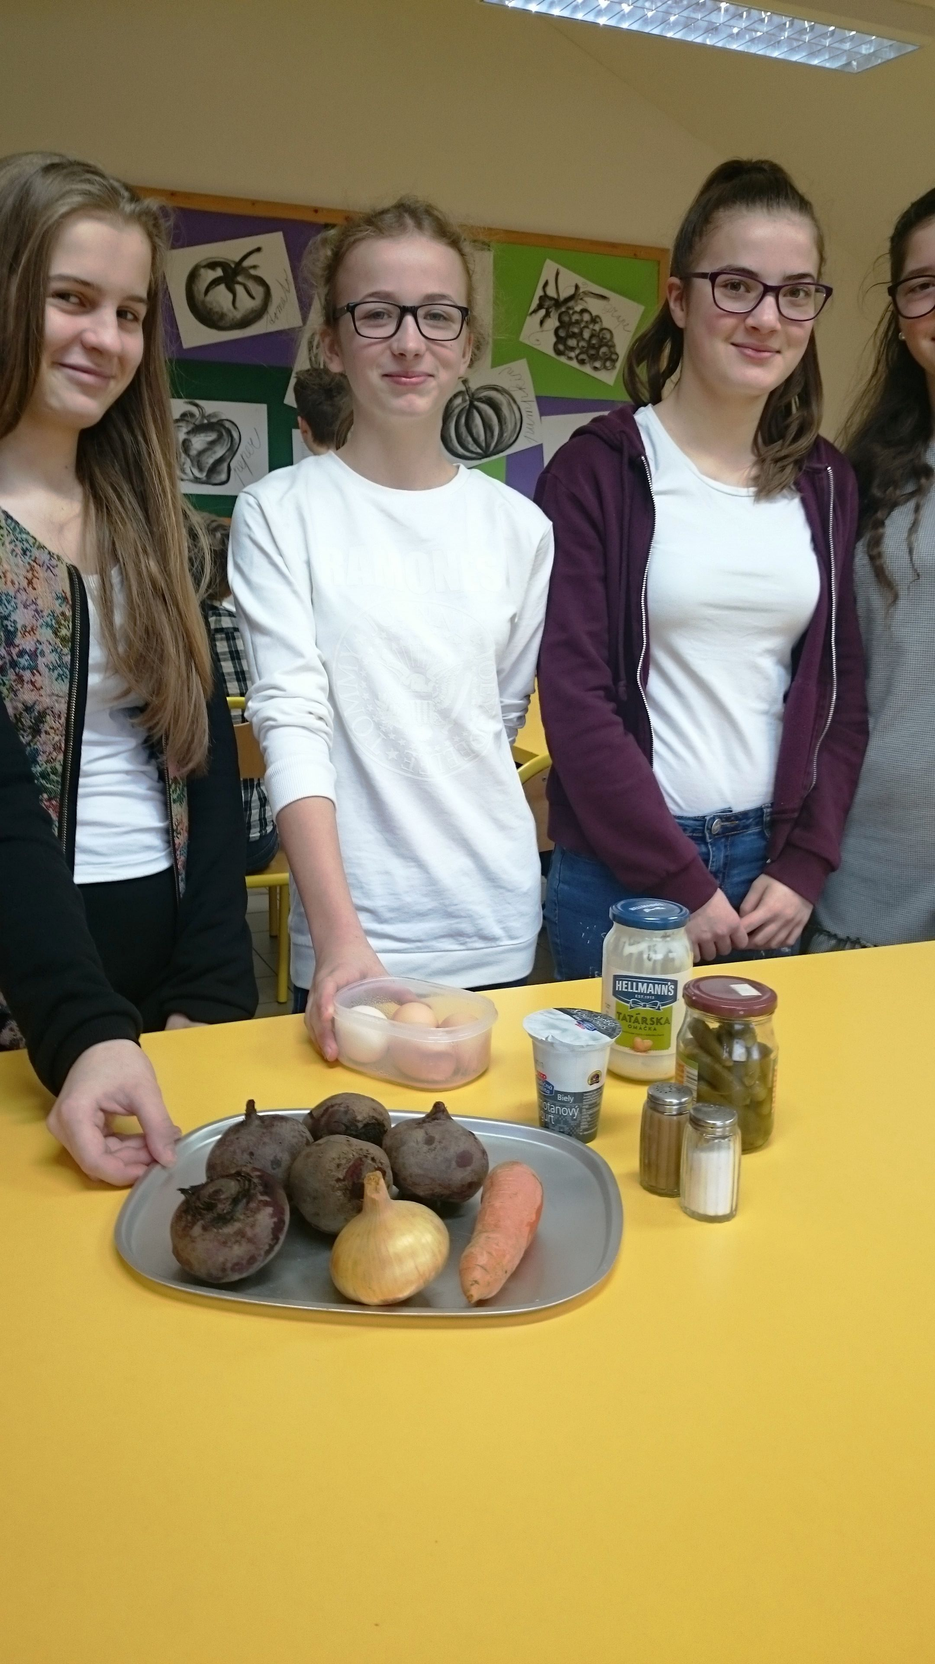
ingredients
We need:
4 beetroots
4 eggs
a bit of salt
a bit of pepper
1 carrot
1 onion
4 sterilized cucumbers
1 teaspoon of custard
2 tablespoons of mayonnaise
1 plain yoghurt

Slide 4
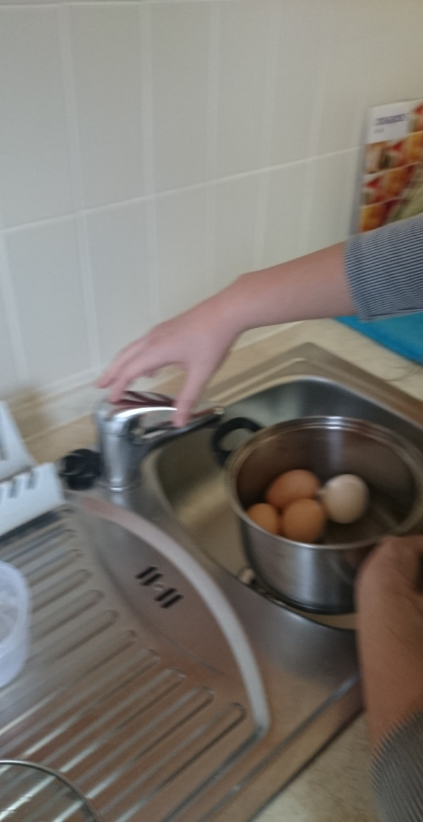
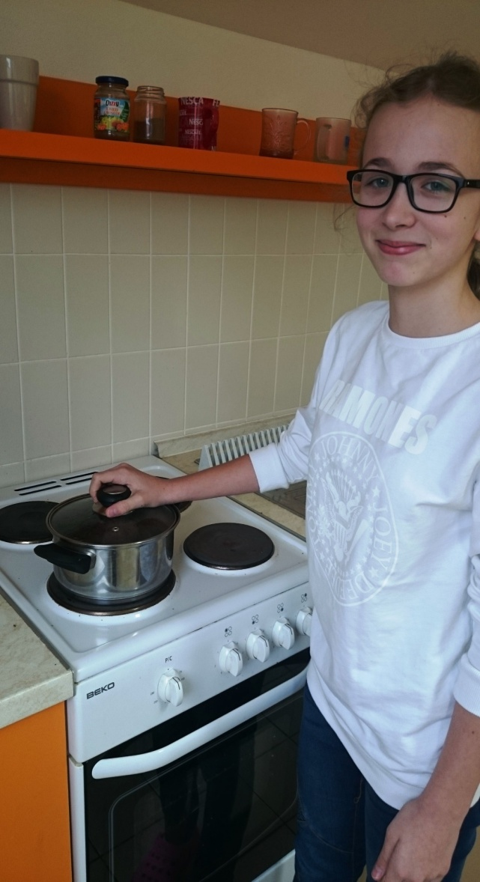
Procedure: BOILING: BOIL EGGS FOR 15 MINUTES BOIL CARROT FOR 30MINUTES BOIL BEETCARROT FOR 30 MINUTES

Slide 5
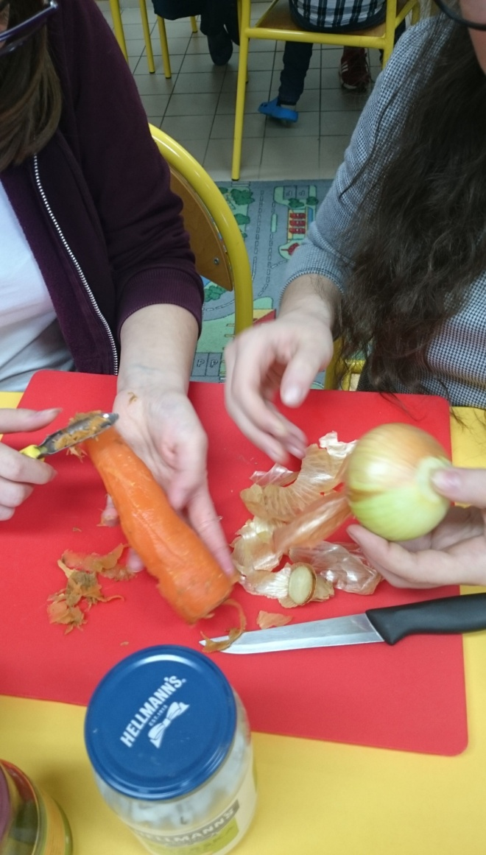
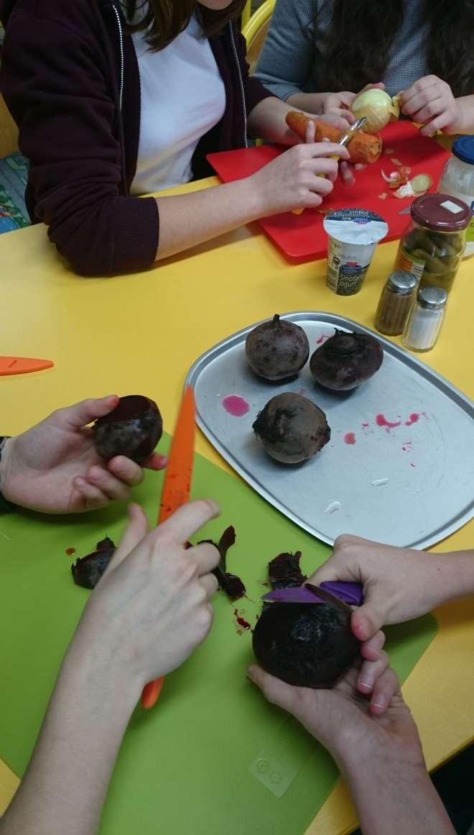
Peeling – peel carrot, eggs, and beetroot

Slide 6
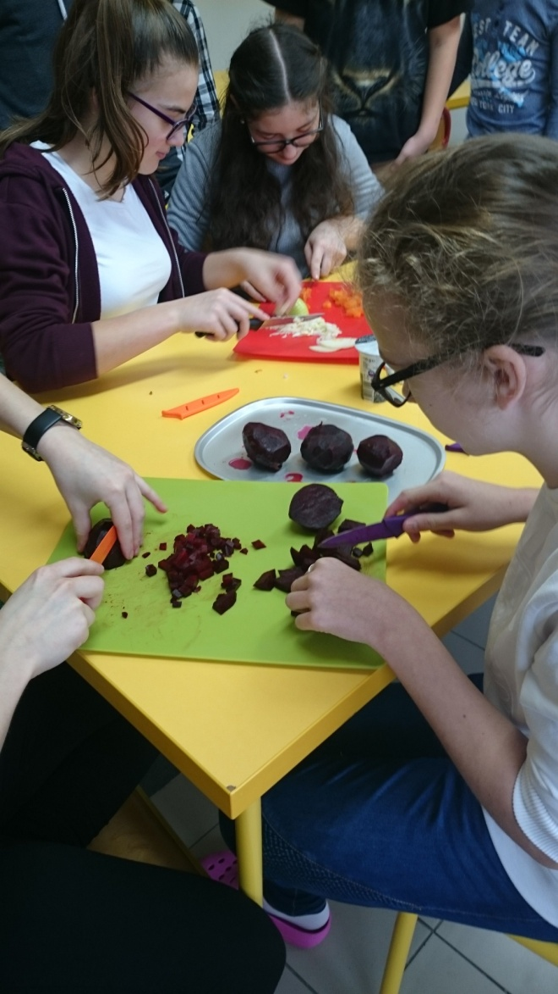
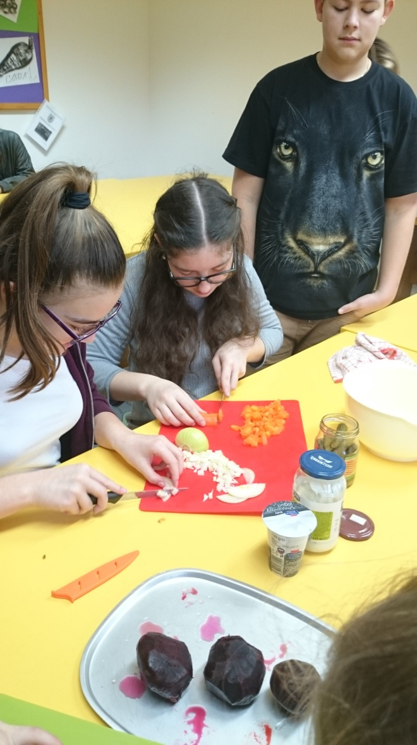
Cutting – cut boiled beetroot, onion, carrot and cucumbers into small pieces

Slide 7
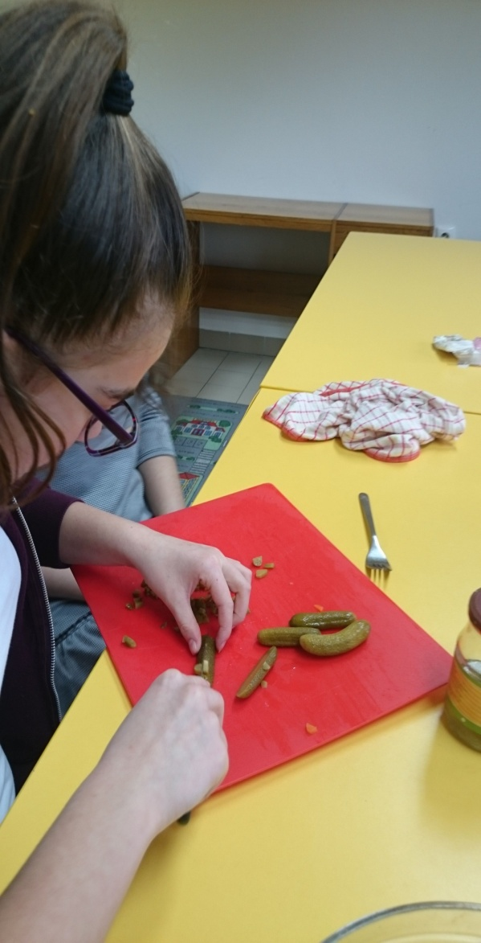
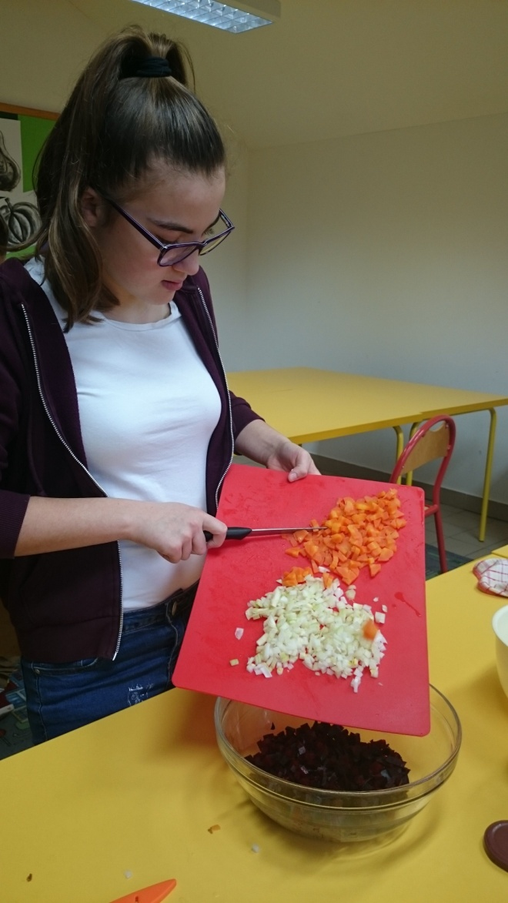
Put all cutted pieces into the bowl

Slide 8
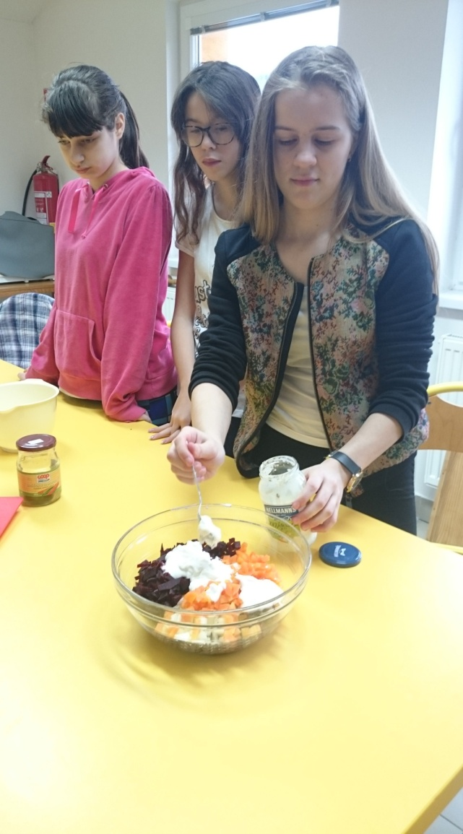
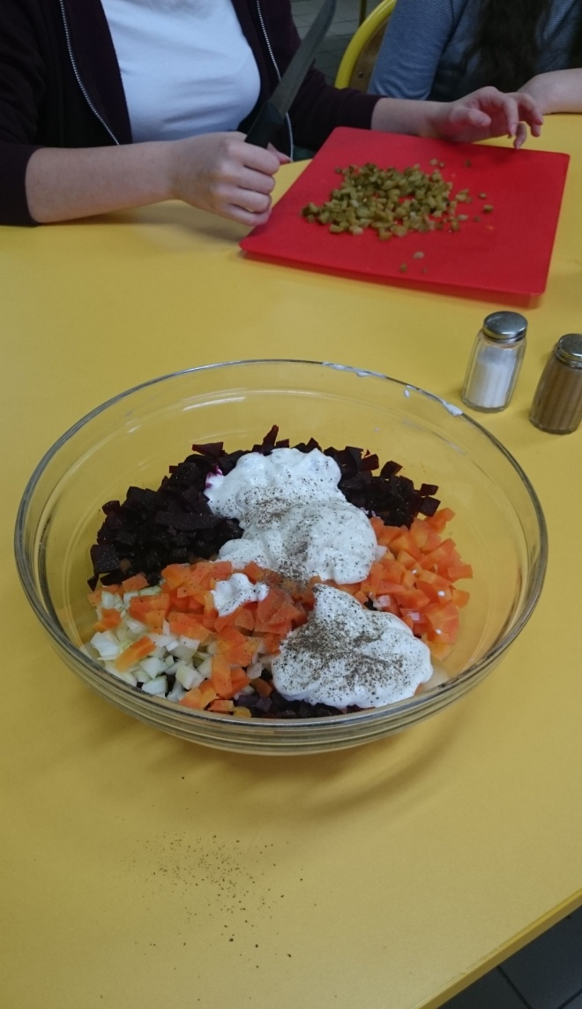
MIXING: PUT - 2 tablespoons of mayonnaise 1 plain yoghurt SOME SALT AND PEPER

Slide 9
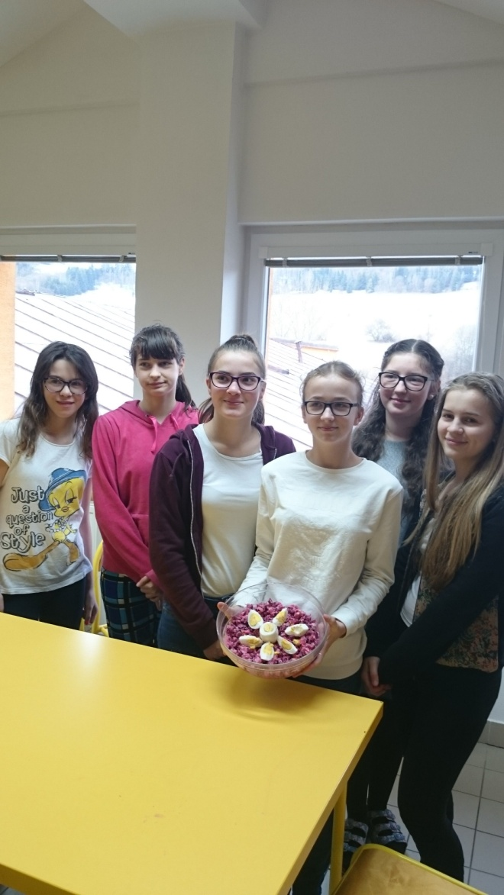
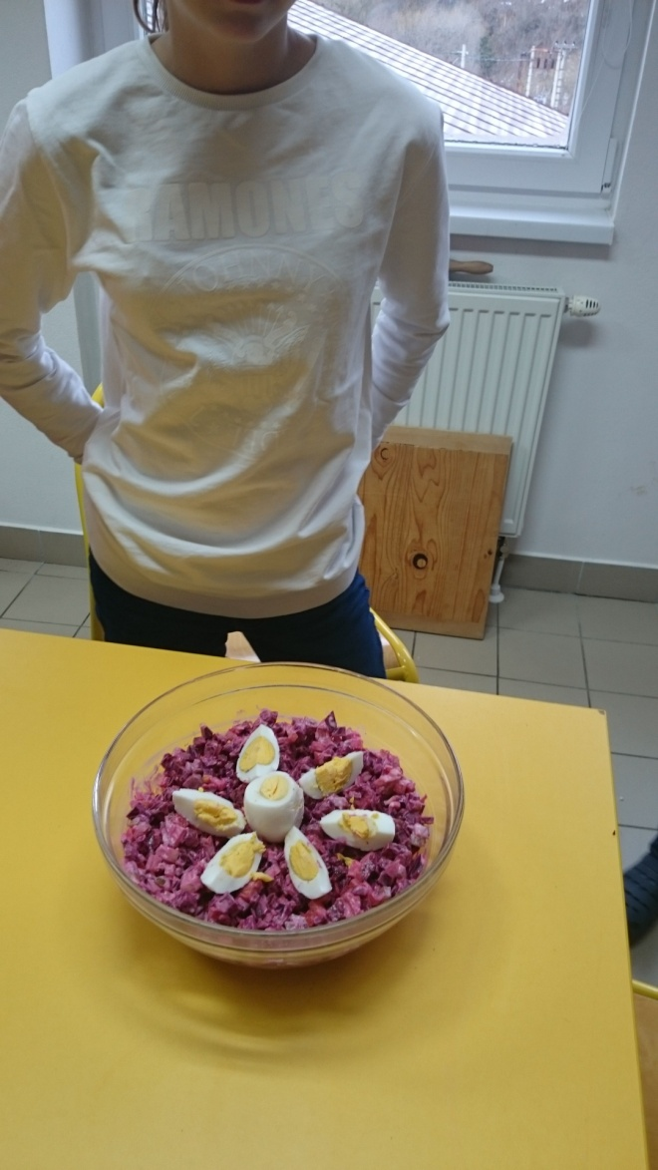
Finished product

Slide 10
It was really tasty

